Slide 1
Myths About Aging
Notes:
Hello my name is Marcela Escobar.

Slide 2
Have you ever heard?
“All elder abuse happens in nursing homes.”
“If an older person is being abused it will be obvious.”
“Educated people don’t fall for scams.”
“If older people say that they are not being abused, it isn’t happening.”
“Elder abuse is no big deal.”
“Strangers and paid caregivers are the ones preying on older people.”
Notes:
I was an individual that believed that there was not a problem with elder abuse. Since I have become part of the EVOC Program I been made aware of the rising issues with elder abuse. I personally am part of CASA in Sebastian County and the lead in children’s ministry at my church because my passion is with children. As we move through life we go from being fully dependent, to independent, and then slowly go back into a more dependent role.

Slide 3
Facts
Neglect and self-neglect are the most common types of abuse. Emotional abuse and financial exploitation are close behind.
90% of all elder abuse cases are perpetrated by family members.
Approximately 1 out of 44 cases are reported regarding elder abuse crimes.
Notes:
The reason that these events are not reported at a higher rate is due to the elder individual being scared that they may be taken from their home and placed within a facility. The individual may think that being abused or scammed may be a reflection of their ability to make clear judgment calls because they did not realize that they were being scammed. The truth is that no matter your age, or if you work in a field that educates regarding avoiding risks of being victimized, you can still be victimized. The scammer works to perfect their sales pitch, to even answer questions from skeptics that are trying to prove the person is who they say they are, but no matter how hard an individual tries to defraud the situation most will still become victims. That is why it is our responsibility to reach out to our community and educate them regarding scams and how to report them. Any person can provide education. It takes one person to start the chain of communication and the ability to decrease the incidence of victimization.

Slide 4
Perpetrators
Outside of nursing homes spouses or partners made up nearly 60% of all perpetrators of physical abuse.
Other known suspects
Intimate partners
Adult children/grandchildren
Other family members
Individuals who befriend older adults
Strangers (i.e. scammers)
Caregivers
Others in positions of authority
Accountants
Faith community leaders
Notes:
An example would be a stranger claiming to be a faith community leader showing up at the door of an elderly individual, introducing themselves and stating that they are going door to door to request donations to assist with building costs of a local church. The elderly individual, assuming that the money is going to a good cause writes a check in the amount of $25,000. The elderly individual ended up being financially exploited and lost $25,000 of their savings and the church was never built.

Slide 5
In the United States, 1 out of 10 aging adults will fall victim to elder abuse annually.
Notes:
Very scary when you are talking about walking into a senior center and on a typical day there are 30 participants present that would equate to being 3 within the center that have been abused in some way.

Slide 6
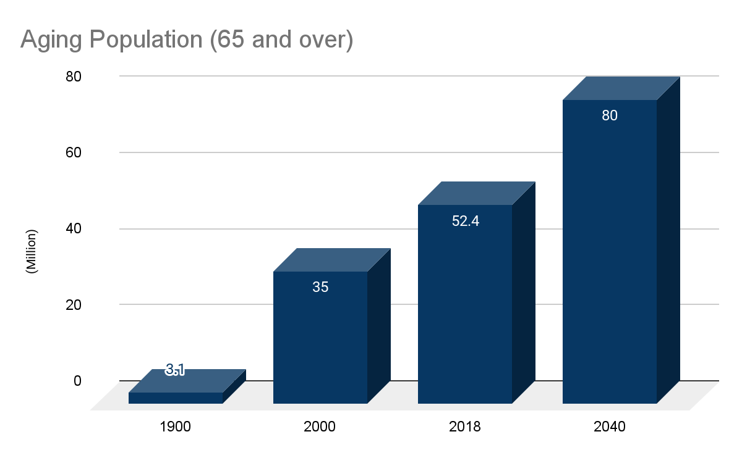
An Aging Population
According to the National Center on Elder Abuse, in 2018, there were 52.4 million adults age 65 or older within the U.S. This number is expected to rise 65.5% in the year 2040, totaling 80 million aging adults.
In 2034, it is estimated that the aging population for the first time in our country will exceed the number of children 0-18 years.
Notes:
This reflects the growing population of elderly. This would translate into 5.2 million adults being victimized in 2018 and is expected to rise to 8 million that may be exposed to abuse in the year 2040..

Slide 7
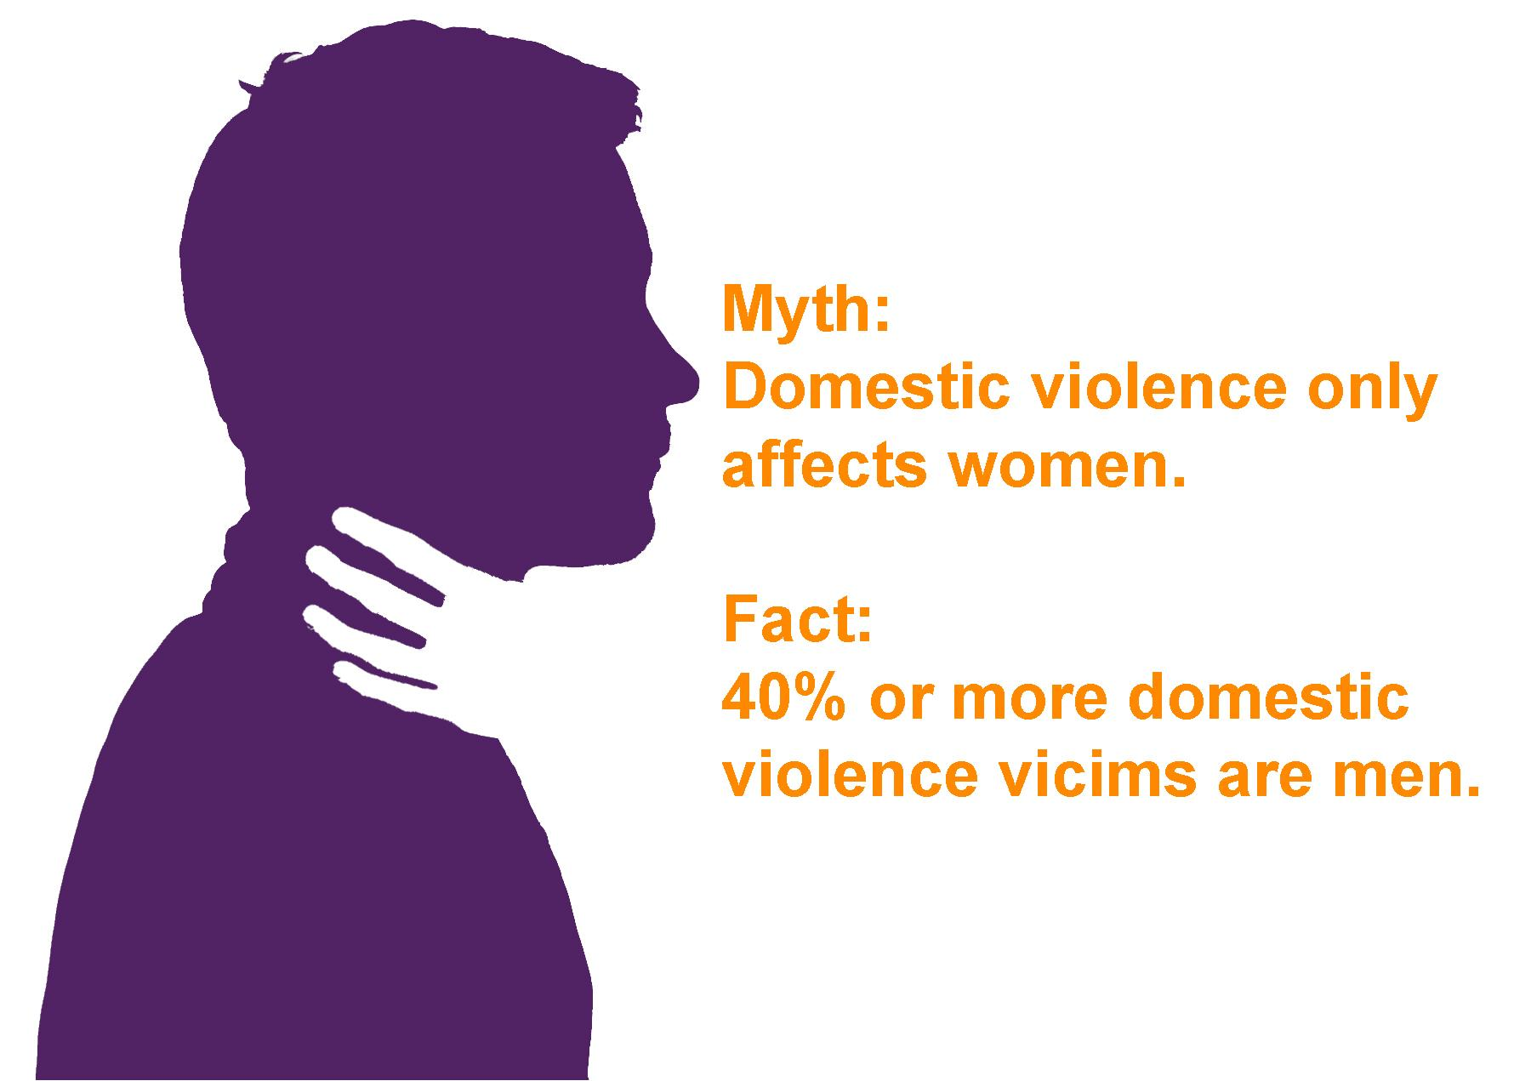
Types of Abuse
Physical Abuse
The intentional or reckless use of force or coercion that may result in bodily injury, pain, or impairment.
Acts of violence that include, i.e. hitting, beating, pushing, shoving, shaking, slapping, kicking, pinching, and burning.
Any unlawful, excessive, or unnecessary use of physical or chemical means to restrain or confine an elder; such as force-feeding, over medicating, and physical punishment.
Notes:
Example: Giving an elderly individual too many pain medications or other medications that lead to sedating effects in order to avoid having to complete a task or need such as feeding/cleaning.

Slide 8
Types of Abuse
Sexual Abuse
Non-consensual sexual contact of any kind with an older adult, perpetrated through force, threats, or the exploitation of authority.
Sexual abuse includes, but is not limited to, unwanted touch, sexual assault or battery, sexual harassment, and sexual interaction with elders who lack the capacity to give consent.
Making an elderly individual take part in viewing sexually explicit movies is also included in sexual abuse.
Notes:
One thing that goes unnoticed is when there is a married couple that one of the participants does not agree with the sexual interaction and is still forced to comply. This is still recognized as sexual abuse.

Slide 9
Types of Abuse
Emotional or Psychological Abuse
The infliction of anguish, pain, or distress through verbal or nonverbal acts.
Verbal assaults, insults, threats, intimidation, humiliation, isolation, and harassment.
Notes:
Each individual square is depicting an event/episode where an insult, threat, harassment, intimidation, and/or humiliation has occurred. Over time, it can have a psychological impact on a person after being subjected to these recurring events/episodes. These events can be self-inflicted but can be deeply impactful when received from others with the intention to tear or beat down an individual. After being called insignificant or told that you are incompetent over and over no matter how hard you try to fight the damaging effects from the negative impact, you are still eventually broken, shut down, and possibly unwilling to join in with conversations. “Why should I try to speak to anyone? Why do I need to take my medications? Why take care of myself? I am unworthy.” Being emotionally abused over an extended period of time can cause a disillusion of oneself.

Slide 10
Types of Abuse
Financial Abuse
The illegal or improper use of an elder's funds, property, or assets including, but not limited to misusing or stealing an older person's money or possessions, coercing or deceiving an older person into signing any document (e.g., contracts or will), and the improper use of conservatorship, guardianship, or power of attorney.
Notes:
Just like we learned in yesterday’s session from the attorney general’s office.

Slide 11
Types of Abuse
Neglect
Refusal or failure to fulfill any part of a person's obligations or duties of care to an elder which include, life necessities such as food, water, clothing, shelter, personal hygiene, medicine, comfort, and personal safety.
Self-neglect is a phenomenon related to but distinct from elder neglect. Self-neglect is a form of self-harm that may co-occur with, provoke, or be triggered by elder mistreatment. It is characterized as the behavior of an older person that threatens their own health or safety, including but not limited to the refusal or failure to provide themselves with life necessities.
Abandonment is oftentimes considered a subtype of neglect and other times believed to constitute a separate category of mistreatment.[55] By definition, it is the desertion of an older adult by an individual who has physical custody of an elder, or who has assumed responsibility for providing care for that elder.

Slide 12
Signs
Physical Abuse
Bruises, abrasions, welts, lacerations, or rope marks
Head trauma and/or bone fractures
Open wounds, cuts, punctures, untreated injuries in various stages of healing
Sprains, dislocations, and internal injuries/bleeding
Bite, strangulation, burn marks, or patterns of injury
Falls, including broken eyeglasses or frames
Medication overdose or chemical restraints
Sudden behavioral changes (i.e., cowering, flinching, blocking to protect)
Notes:
There are signs that we can observe to alert us to an elder victim being victimized.

Slide 13
Signs
Sexual Abuse
Bruises, abrasions, or lacerations around the breasts or genital area
Unexplained sexually transmitted disease or genital infection
Unexplained vaginal or anal bleeding or incontinence
Increased anxiety or depressive symptoms
Sleep disturbances, agitation, or restlessness

Slide 14
Signs
Emotional or Psychological Abuse
Emotional distress or agitation
Withdrawal from activities of daily life
Uncommunicative or non-responsive
Unusual behaviors commonly attributed
to dementia (e.g., sucking, biting, rocking)
Lack of self-care
Lower self-esteem, feelings of despair, or
a sense of worthlessness

Slide 15
Signs
Financial Abuse
Sudden changes in bank account or banking practices, including an unexplained withdrawal of large sums of money or the addition of signatories to an older person’s bank signature card
Abrupt changes to a will or other financial documents
The unexplained disappearance of funds or valuable possessions, or sudden transfer of assets
Substandard care provision, unpaid bills, or eviction proceedings
The provision of unnecessary services
Depression or anxiety
Evidence of poor financial decision making
Malnutrition
Notes:
Banks for the most part are aware of large sums of money being transfered and that the activity is fishy, but if the elder adult is fully competent then there is not much the bank can do to push the issue. It is the account holder’s business on what is purchased and money is spent toward. Romance scams are the perfect example that can encompass all of these bullet points above. An elderly individual is contacted and made to think that a member of the military is working as a doctor abroad and will return to the states to take all the elder victims problems and especially their loneliness away. As the communication continues between the two, money is requested for paying off doctors for an emergency medical procedure, a plane ticket, or a money transfer is requested because they can not access their bank information from overseas, but promises to return every dime when they come and take the individual away from the nursing home or unpleasurable situation they currently are in. The scammer does not care who the money is coming from, they can not see the elder individual that comes in on a weekly/monthly basis requesting assistance to pay their utility bills or food because they have sent all of their money to their fiance overseas.

Slide 16
Signs
Neglect
Dehydration or malnutrition
Untreated bed sores
Poor personal hygiene
Unattended or untreated health problems
Unsafe and unsanitary living conditions
More info can be found at ncea.acl.gov
Notes:
All the different signs that have been discussed; physical, sexual, emotional/psychological, financial, and neglect can all coexist with one another for the elder victim. It can be a difficult and daunting task to gain the trust of the individual and assure them that not only will their individual story be kept confidential but that the services rendered are free to them under the Victims of Crime Act who holds the funding of our program.

Slide 17
Next Steps
Try talking to the senior you are worried about. Let him or her know that you want to help because you think something is wrong. They may not answer your questions, but if he or she tells you they are being hurt or are in danger, call 911 right away.
If the abuse is coming from a hired caregiver, you may be able to file and report the person to appropriate parties. If the abuse is coming from a care community, you have the option to move your loved one out of the facility. If the abuse is coming from a friend or family member, you can take steps to make sure that person is prevented from seeing the senior.
You will also want to reach out to the proper authorities. You do not need to have proof that abuse is occurring to make a report – you simply need to let the professionals know, and they will take over and investigate the situation.

Slide 18
Next Steps
4) If it is a non-life-threatening situation, contact your local Adult Protective Services (APS) Agency. You can also visit the National Center on Elder Abuse to find resources in your state or call the Eldercare Locator (1-800-677-1116) for a referral of agencies who can help. If the abuse is coming from a long-term care community, contact your local long-term care Ombudsman.
5) Report all incidents of scams (lottery, romance, insurance, upcharges, investment, and COVID-19), and also inappropriate text messages, emails, questionable mail, and phone calls to www.IC3.gov and they will investigate.
6) If there is a local issue with a neighbor or other individual taking advantage contact local law enforcement and the Attorney General’s Office at oag@Arkansasag.gov, https://arkansasag.gov/resources/contact or call (501) 682-2007 or (800) 482-8982.

Slide 19
Notes:
We are a part of a program called EVOC. We are the first in Arkansas to focus on elder victimization and providing assistance to those 50 years and above. Add mission statement.

Slide 20
Three Qualifying Requirements
Self-identify as a victim of a crime,
Victim must be 50 years of age or older; and
Be a resident of Sebastian, Franklin, or Crawford County in Arkansas.
Notes:
The individual must meet all requirements to be able to take part in the EVOC program assistance.

Slide 21
How EVOC Can Help
We offer
One-on-one counseling
Home window & door lock replacement
Legal aid services (Center for Arkansas Legal Services)
Emergency shelter (short-term stay)
Emergency transportation
Emergency food and clothing
Weekly support groups
Weekly abuse education/prevention training (i.e., fraud, caregiver abuse, physical abuse, and financial exploitation)
Assistance with completing the Crime Victims Reparation and Compensation Application

Slide 22
Contact Info
(479) 424-2035 Or 1 (800) 320-6667 Select prompt “9” after automated system answers.

Slide 23
Area Agency on Aging of Western Arkansas
Elder Housing (Barling, Paris, Booneville, Waldron)
Home Health
Homemaker
Hospice
Ombudsman Program
Personal Care
Transportation Services
Grants (IHA, Supplemental, Respite, Caregiver)
Senior Centers (Meals on Wheels, Socialization, Range of Motion Activities)
Notes:
For more information on services provided through Area Agency on Aging of Western AR please contact (479) 783-4500.

Slide 24
Thank You!

