Slide 1
Caring for our Caregivers

Slide 2
Slide Title
Elisabeth Ann Bostian-Neal
Licensed Clinical Social Worker
Springwoods Behavioral Health
Chief Clinical Officer

Slide 3
What is a caregiver
A caregiver is defined as a family member or paid helper who regularly looks after a child or a sick, elderly, or disabled person. They most commonly assist with impairments related to old age, disability, a disease, or a mental disorder. Caregivers may work in a home or a facility.

Slide 4
Caregiver responsibilities/duties
These may include taking care of someone who has a chronic illness or disease, managing medications, talking to doctors and/or nurses on their behalf, bathing, dressing, chores.
Notes:
Postives,negatives, what do you not want to pass?

Slide 5
Importance
With our aging population this role has become increasingly recognized as so important, functionally and economically. It has become increasingly stressful with Covid.

Slide 6
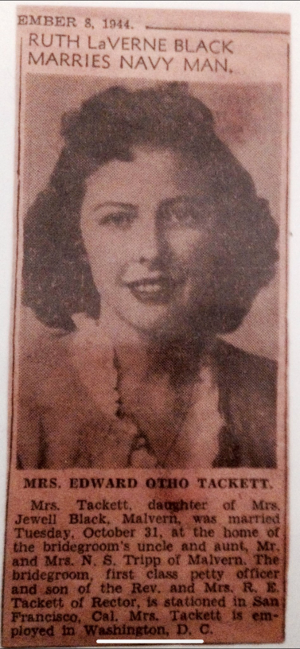
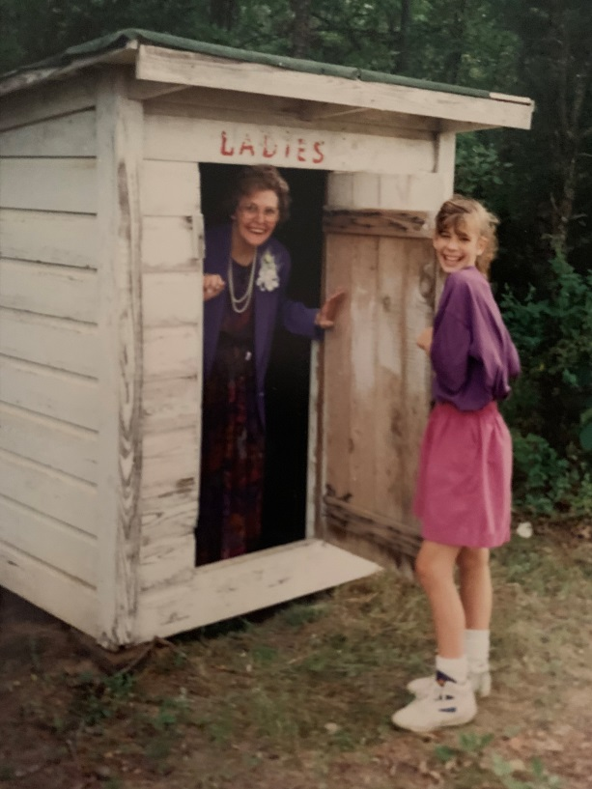
Ruth Tackett 1926-2005
Notes:
Social worker in town, Caring, loved her kids, raised in one parent home, grief, lori, feeding town.andy griffith manipulation

Slide 7
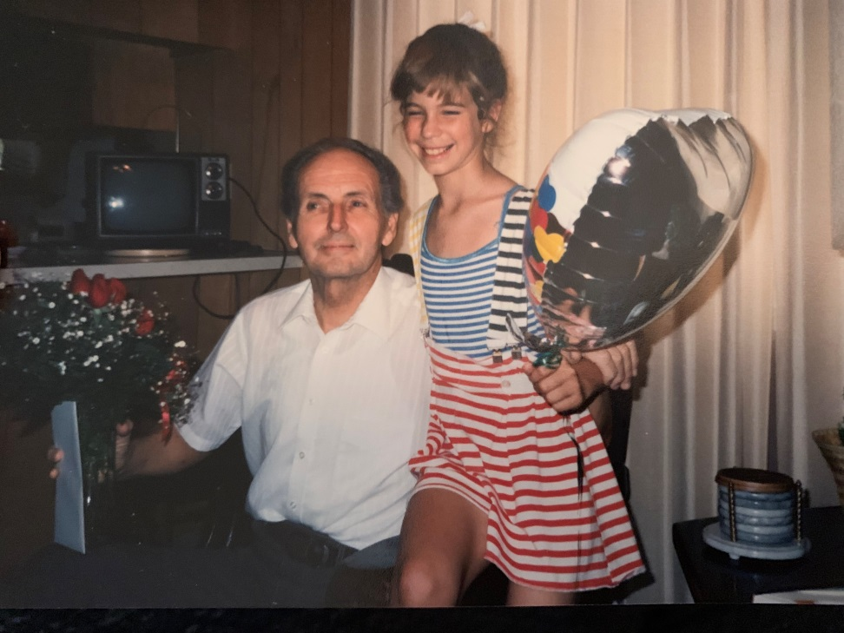
E.O. Tackett
Grandpa Tackett
1922-2005
Notes:
Pastor, depression, mom sick, surgeries when old, so I was special, sang at nursing homes, go to indian store, cherokee alphabet, fav grandpa

Slide 8
Challenges
Covid and social distancing
Mental health
Physical health
Isolation/lack of connection to people
No access to family paid leave (50 percent)
Financial strains (late bills, not paying mortgage, giving up savings, debt
Uncertainty
Notes:
Sit on porch and watch cars to see how they would react, loved having fun, 14 kids, proud of being cherokee, roll #, laudra, mahota, indian toys, storybeth, grandpaps den,

Slide 9
In home care
In a recent study in April of 2021 by the University of Pittsburg, 55% of caregivers were female and 64% were over 65. One third were adult children, 25% were spouses, and 20% were the parent. (Compared caregivers and non-caregivers)
Notes:
Created stress, loved so much, didn’t know better, created so much turmoil, mom, perfect, now arthritis at 27, autoimmune, wanted to please parents, best they could

Slide 10
Challenges of COVID and caretaking
Increased caregiving duties
(more emotionally difficult)
Decline in recipient’s mental health
Trouble with access to providers
Difficulties getting food and medical supplies (paying for food)
Anxiety, sleep disturbance, fatigue
Notes:
Step towards mental health and a new way of thinking, mom left unhappy marriage, got her masters in counseling, I attended night class, hip replacements, joins in hands and feet replace

Slide 11
Burnout
Burnout is a combination of 3
Emotional exhaustion-emotional resources depleted
Depersonalization-cynicism towards clients
Reduced personal accomplishments-negative evaluation of work ability

Slide 12
, Taking care of caretakes
We are in this together (Normalize)
Take a walk/garden
Check in on each other
Access community resources
Mindfulness/prayer/relaxation
Spend time virtually/zoom

Slide 13
Caregiver support groups
There are many groups, ranging from zoom to blogs
Stuctured/unstructed
Group or one on one

Slide 14
51% of caregivers surveyed stated they do find meaning in the caretaking, and not only love, but put the love into action.

Slide 15
Signs and symptoms of depression (in the elderly)
Sadness and/or despair
Unexplained or aggravated aches/pains
Loss of interest in socializing/hobbies
Weight loss or loss of appetite
Feelings of hopelessness or helplessness
Lack of motivation and energy
Notes:
This is funny, but seriously, who are we, What are you proud of, would anyone guess this was you. Game, put on paper some special and guess who
What if no one knew this? Knew you?

Slide 16
How can we help?
Normalizing (losing independence, loved ones, physical health, loss of
purpose, isolation)
Overcoming depression may involve adapting to change, finding new things you enjoy, connecting to your community and loved ones
Notes:
Dad, seasonal affective disorder, normalize

Slide 17
More….
Gratitude
Pets
Purpose
Clubs/classes
on-line groups/friends
Write memoirs
Eat and sleep
Notes:
Don’t have to be perfect, can be flawedCBT, learned at 9

Slide 18
Reminder
While caring for others, remember they are their own person with their own human dignity, and to be respectful of their space and boundaries.

Slide 19
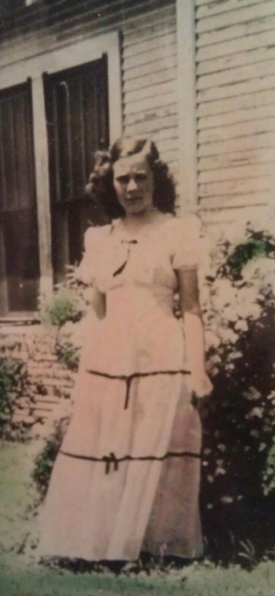
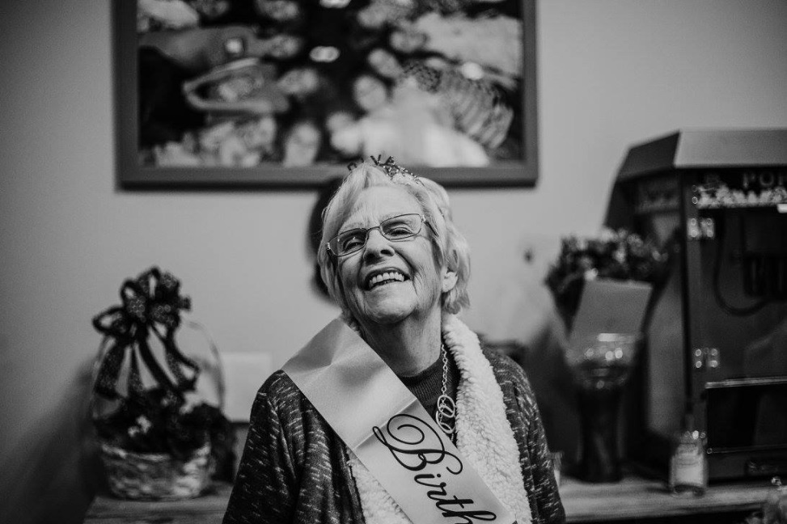
Mary Mason Bostian
Notes:
Unhappy, depressed, guilt me into into visiting, changed, so insightful, grateful, get to really know her now, neighborhood kids call her nana

Slide 20
The 4 agreements by Miquel Ruiz
Be impeccable with your word
Don’t take anything personal
Don’t make assumptions
Always do your best

Slide 21
“We can complain because we have rose bushes, or rejoice because thorn bushes have roses.” Abraham Lincoln

